Slide 1
Hospital Management System
By Rahul Sharma and Jayesh Mishra

Slide 2
Introduction
This application has been developed to handle basic scheduling functions of a Hospital.
It’s a well organized software solution for a Hospital or Clinic.
It helps to provide information on any patient present in hospital to the doctor as well as staff member.
Patient can take appointment according to his/her time .

Slide 3
Purpose
The purpose of this project is to provide a friendly environment to maintain the details of patient according to different department members.
The main purpose of this project is to maintain easy circulation system using computers and to provide different reports based of Issue.
Improved Doctor service through greater access to accurate information.
Greater accountability and transparency in operations.
To make the existing system more efficient.
This project is basically updating the manual Hospital system into a software based application so that the doctors can know the details of their account ,availability of patient etc.

Slide 4
Project Aim and Objective
To eliminate the paper work in Hospital.
To record every interaction in computerized system so that problem such as record file missing won’t be happen.
To design a user friendly graphical user interface which suit the doctor and other staff of hospital.
To save the cost and time.

Slide 5
Preferred Technologies
Windows XP/7 operating system
Technology: PHP
Web-Technologies: HTML, CSS, JavaScript
Web-server: Apache 3.0
Database: MySql
IDE: Visual studio code

Slide 6
User characteristics
We have 2 levels of users
1.Patient Side: In patient side, Patient will be able to check the issued time of appointment and scheduling according to the patient efficiency.
2.Administration Side: The following are the sub module in the administration side.
Doctor login
Patient Registration
Data fetching
Realtime Covid
Different Database format

Slide 7
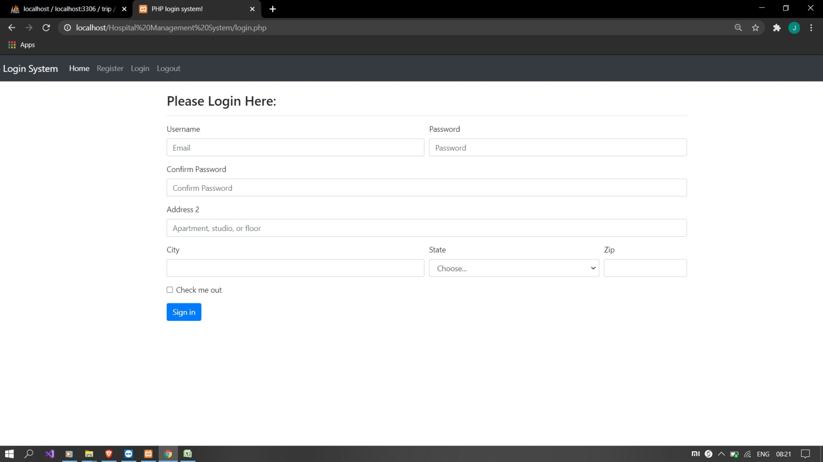
Login Page

Slide 8
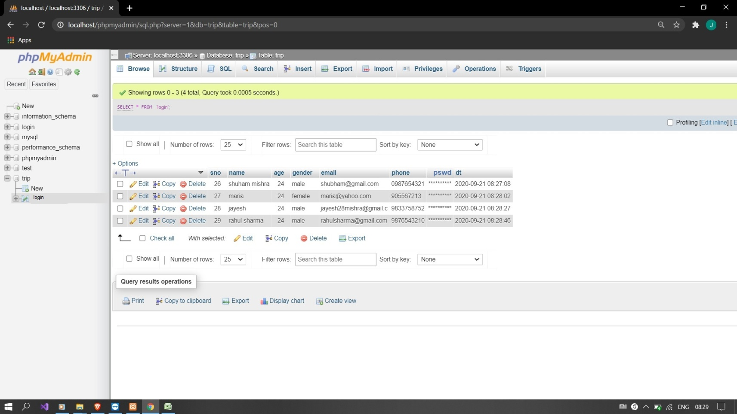
Login Database

Slide 9
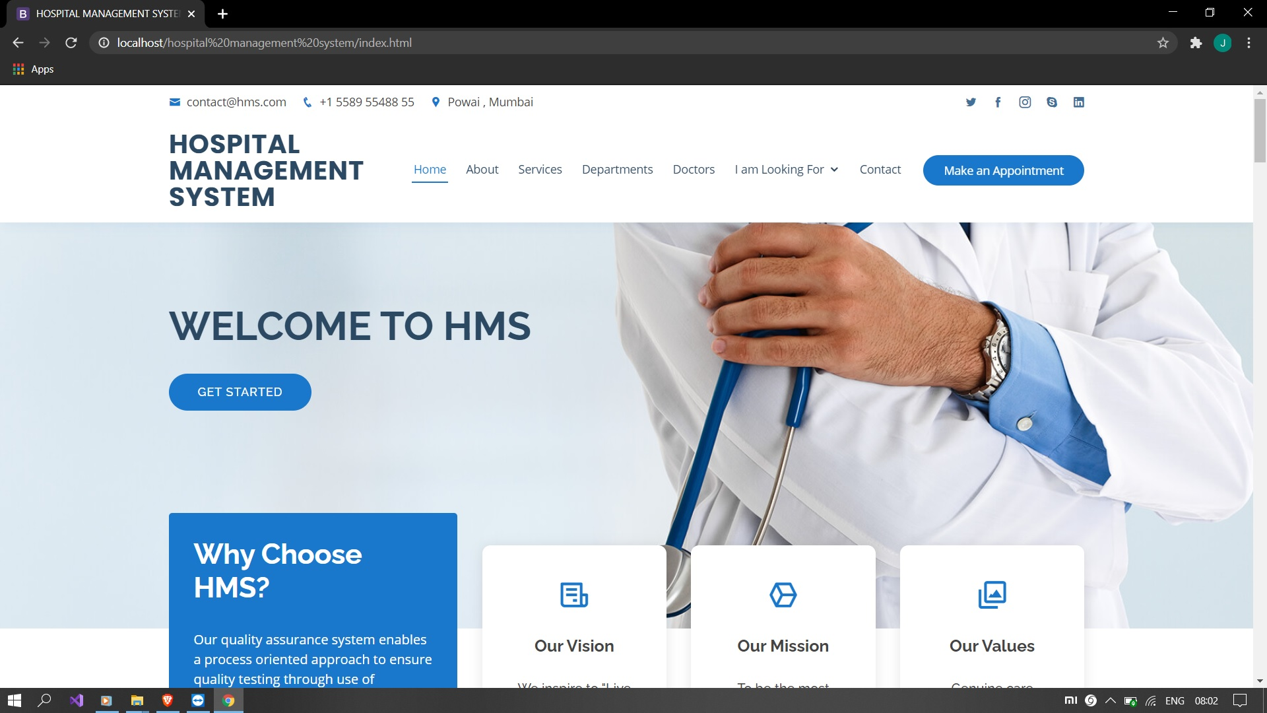
Home page

Slide 10
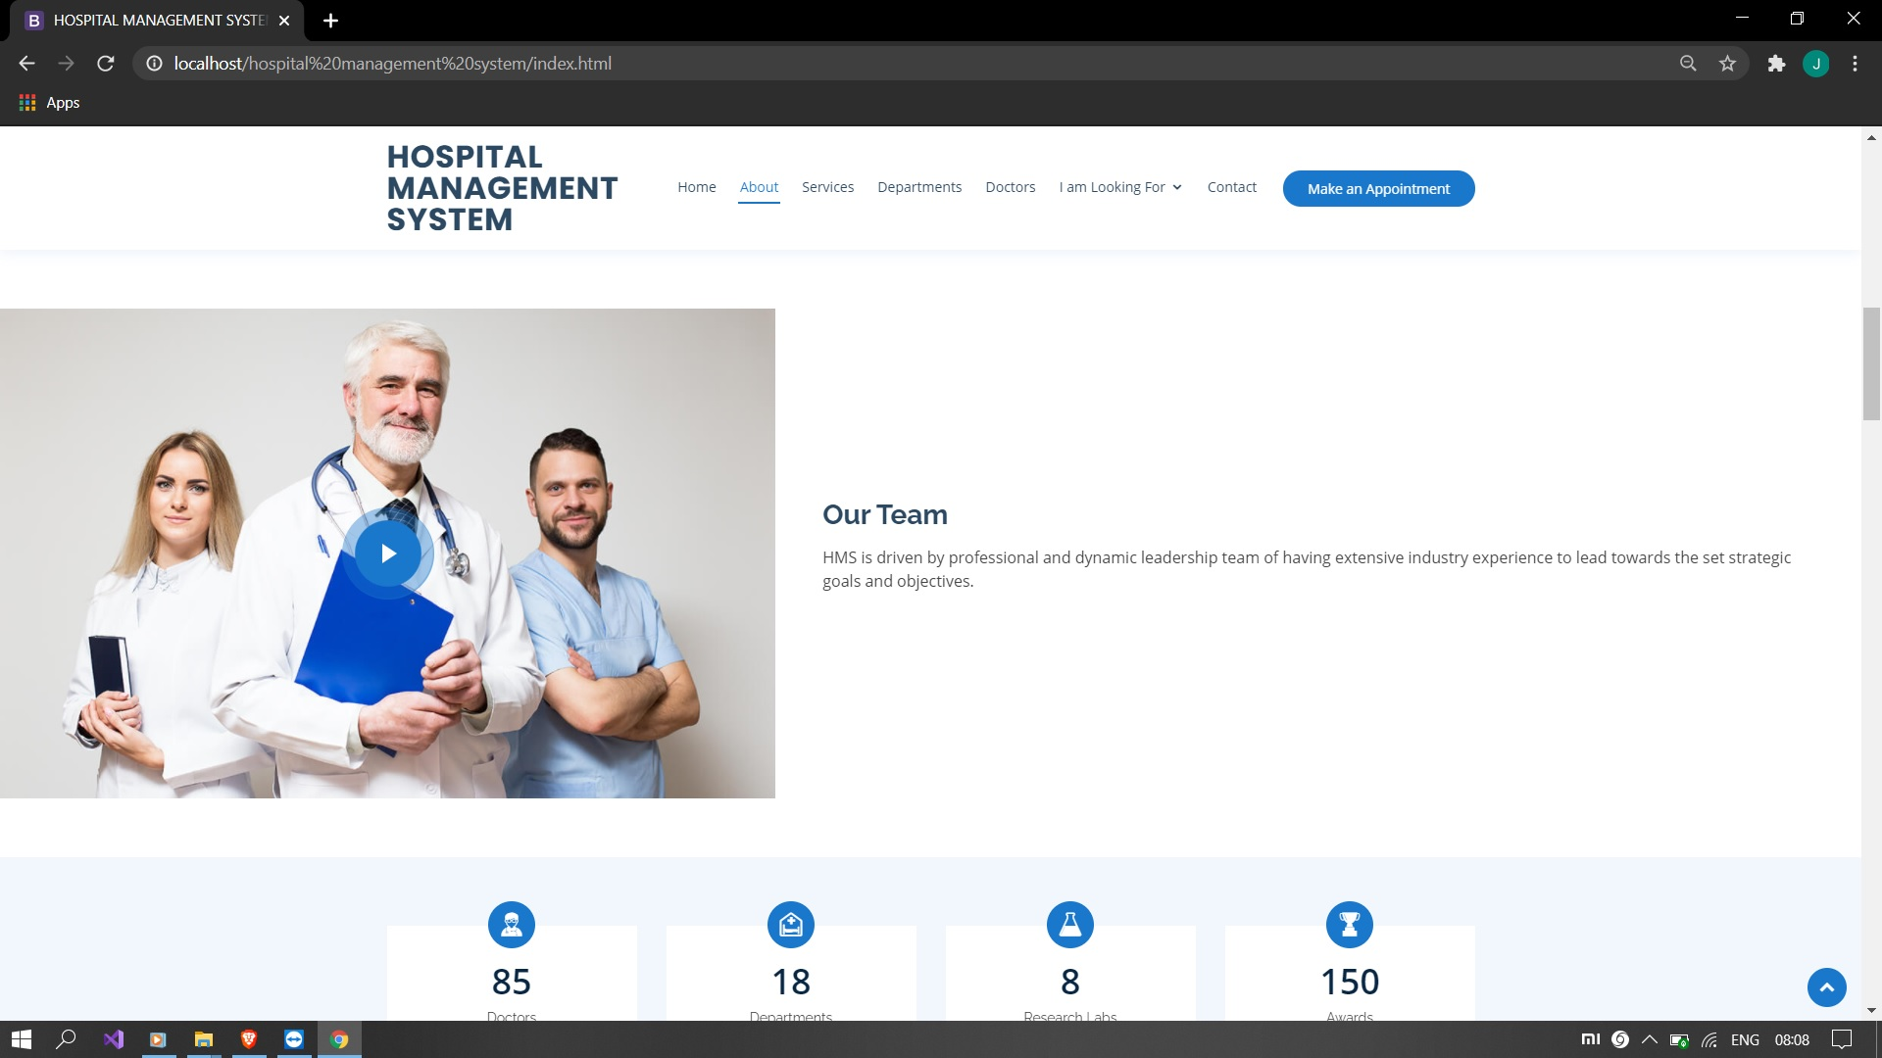
Team page

Slide 11
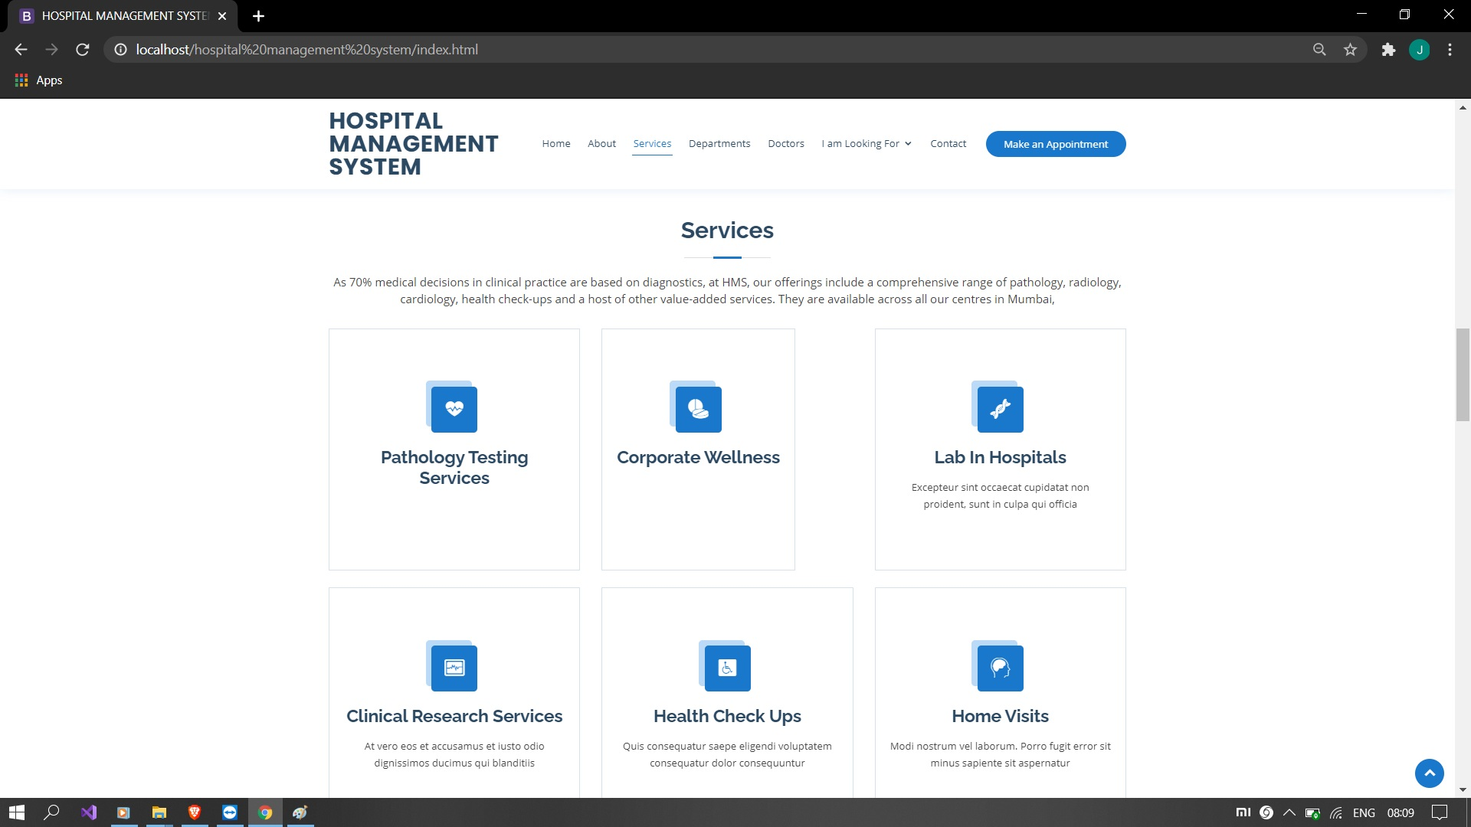
Services

Slide 12
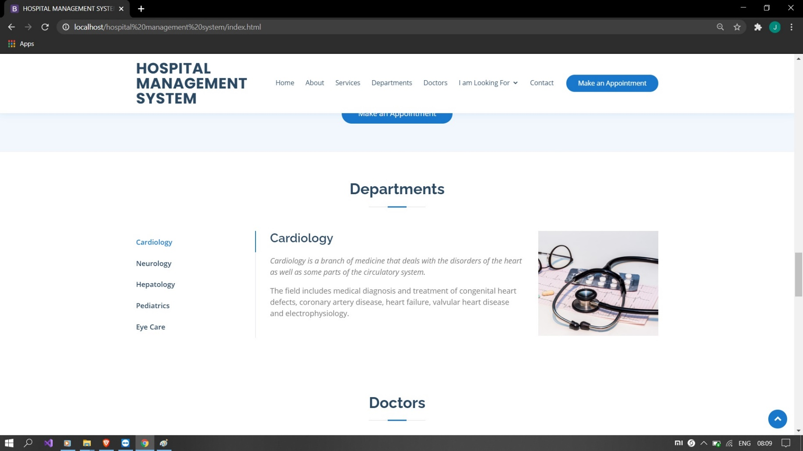
Departments

Slide 13
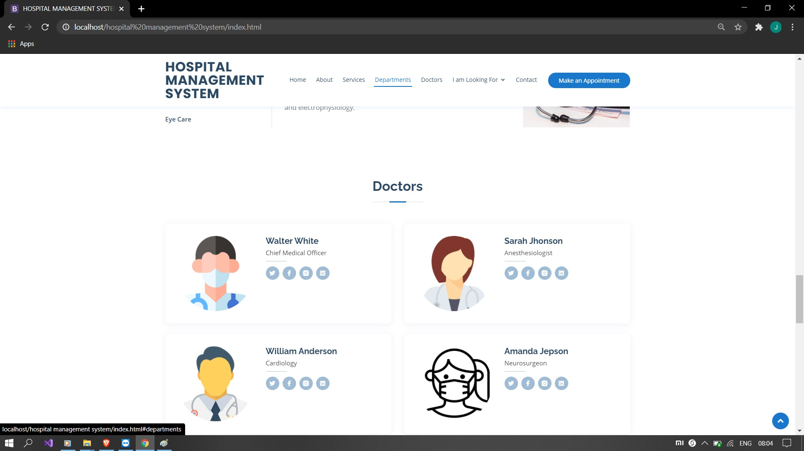
Doctor

Slide 14
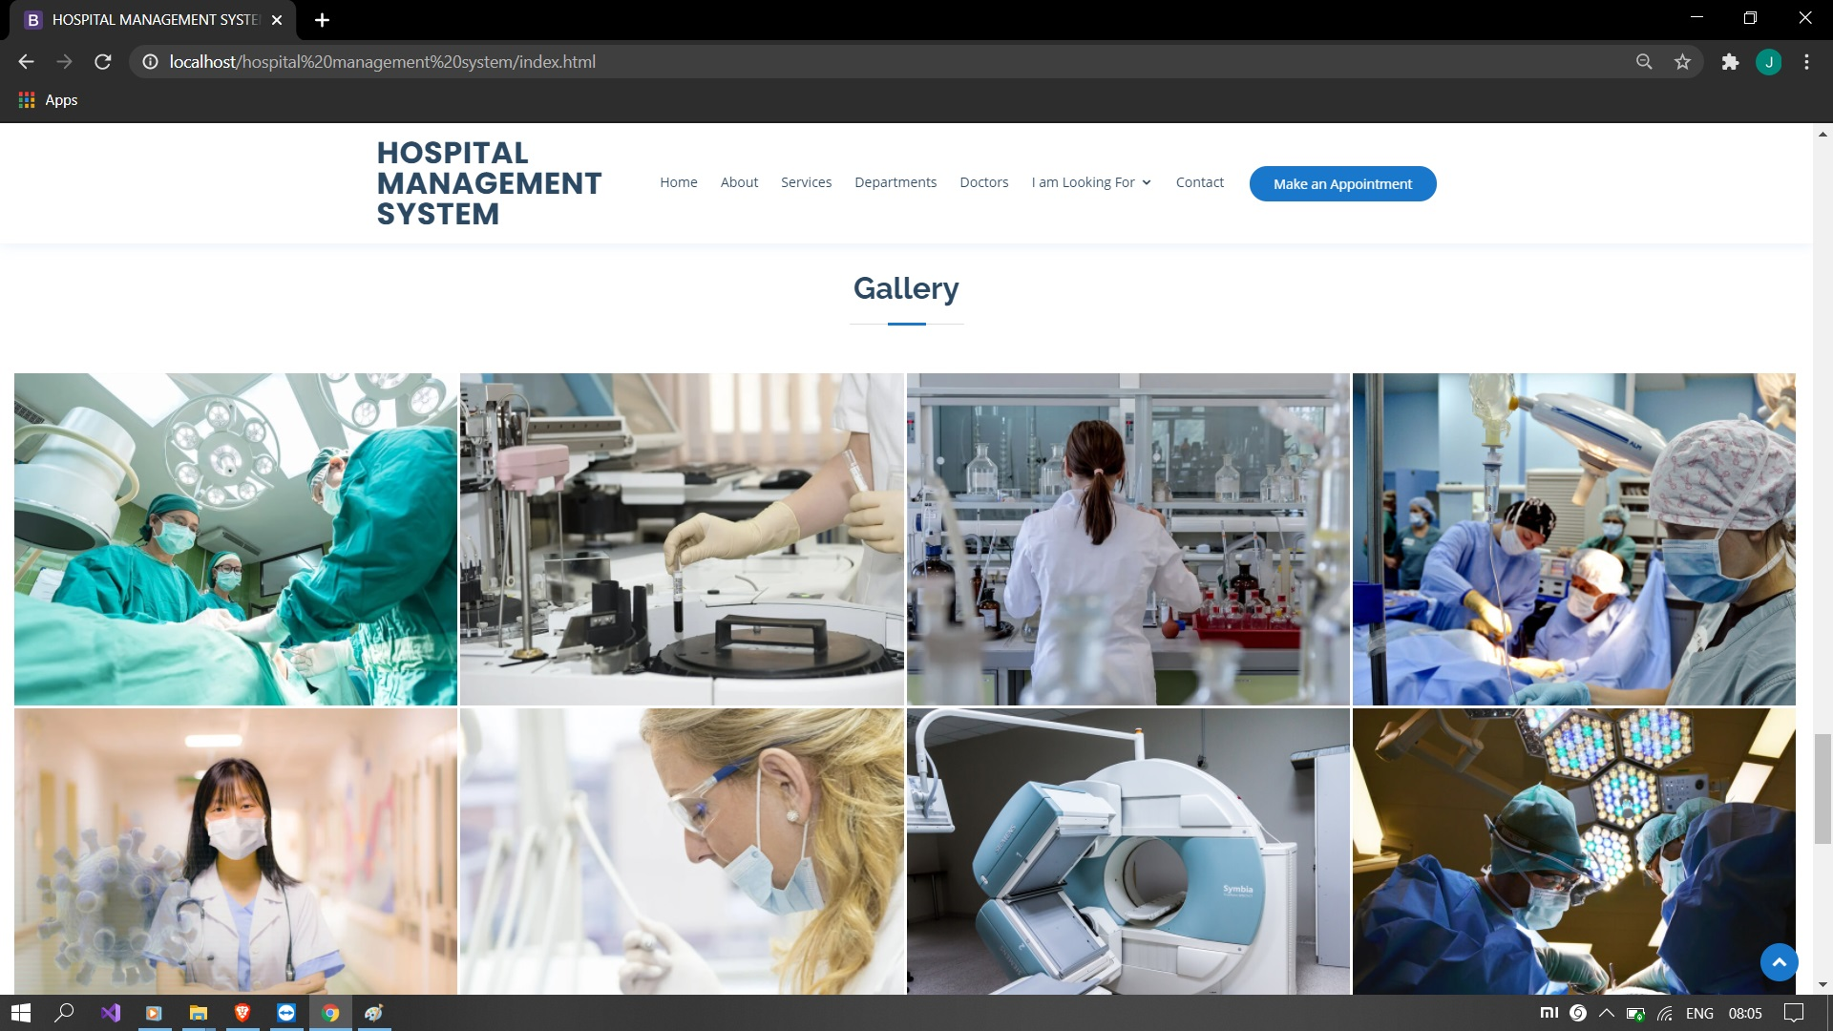
Gallery

Slide 15
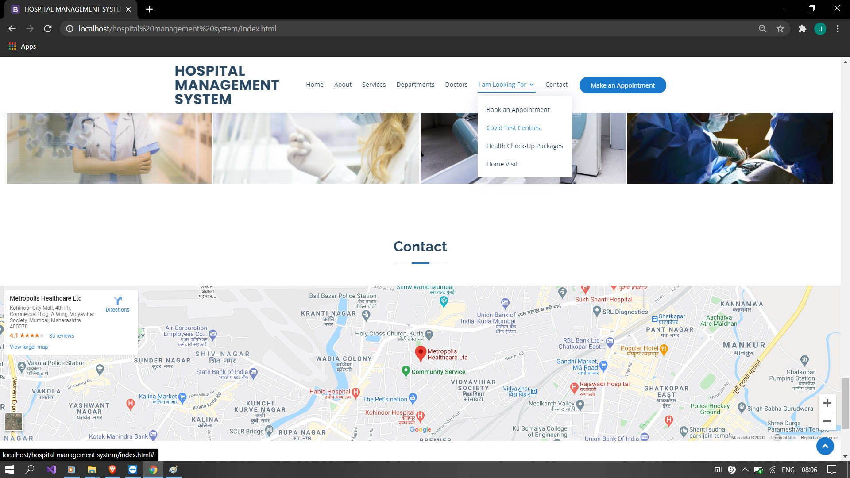
lOCATION

Slide 16
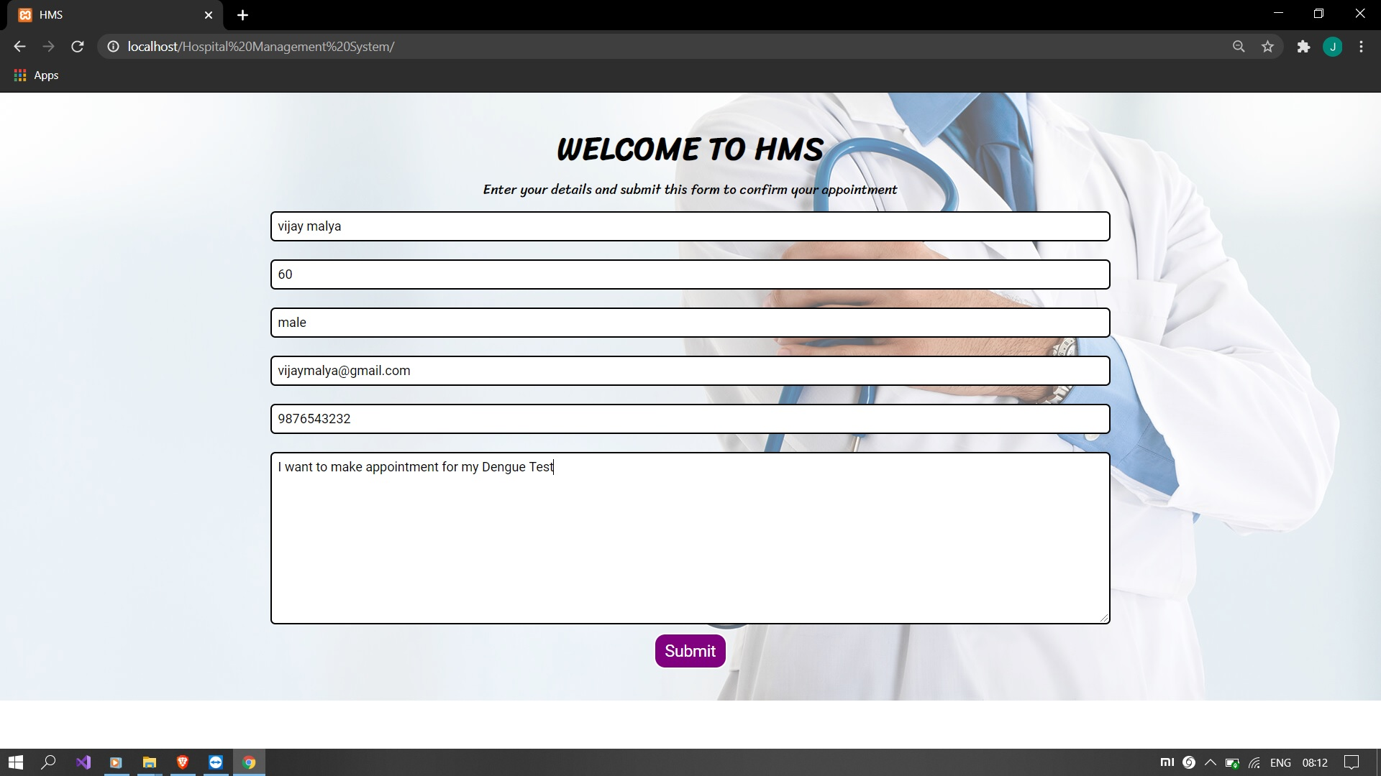
Appointment Page

Slide 17
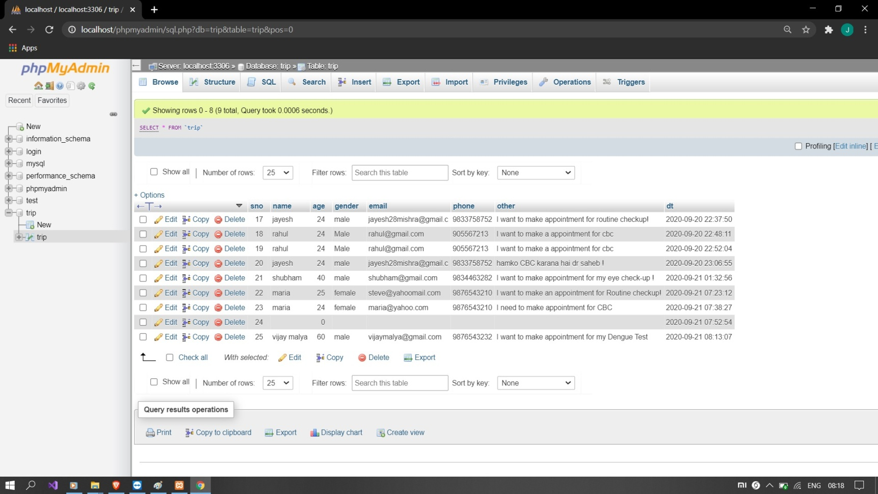
Appointment Database

Slide 18
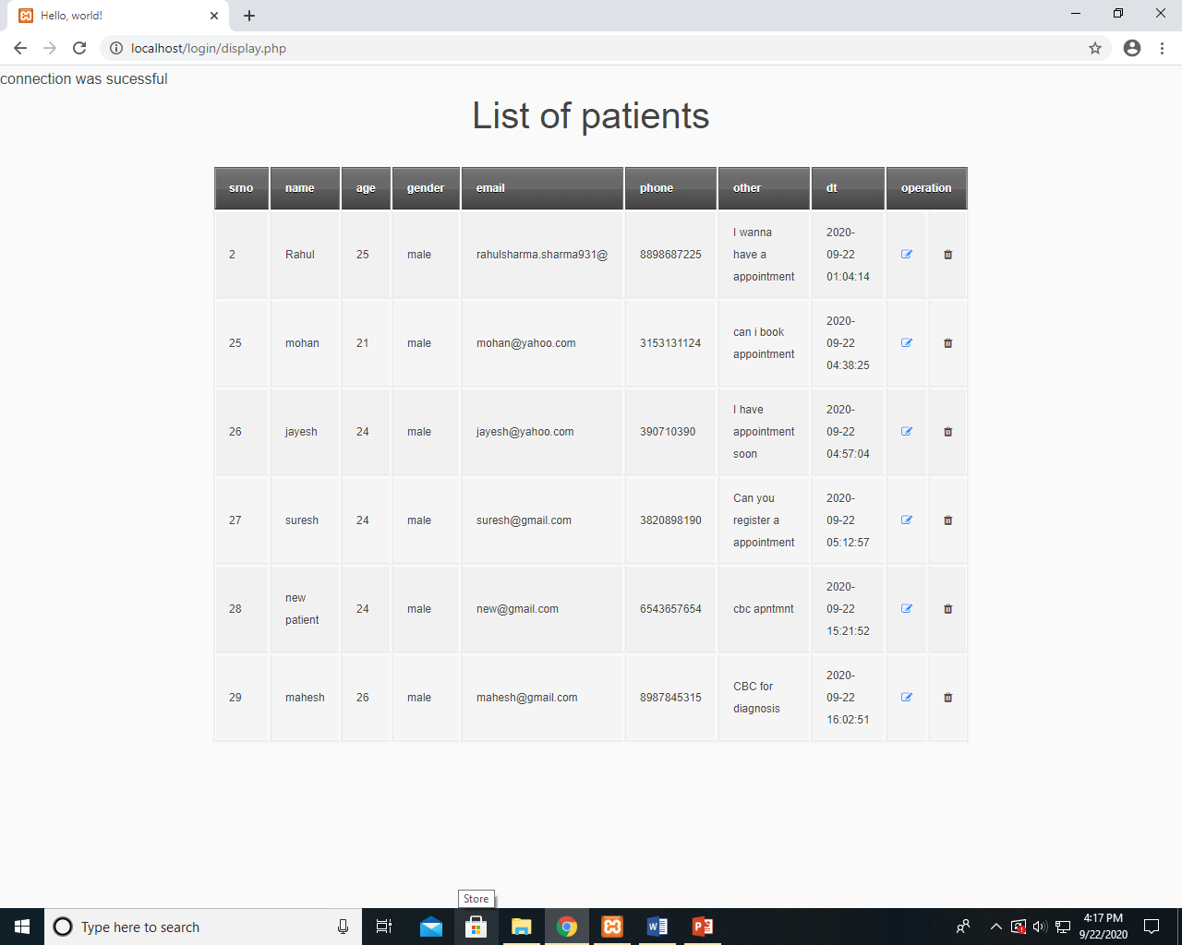
RETRIVE PAGE ON WEB

Slide 19
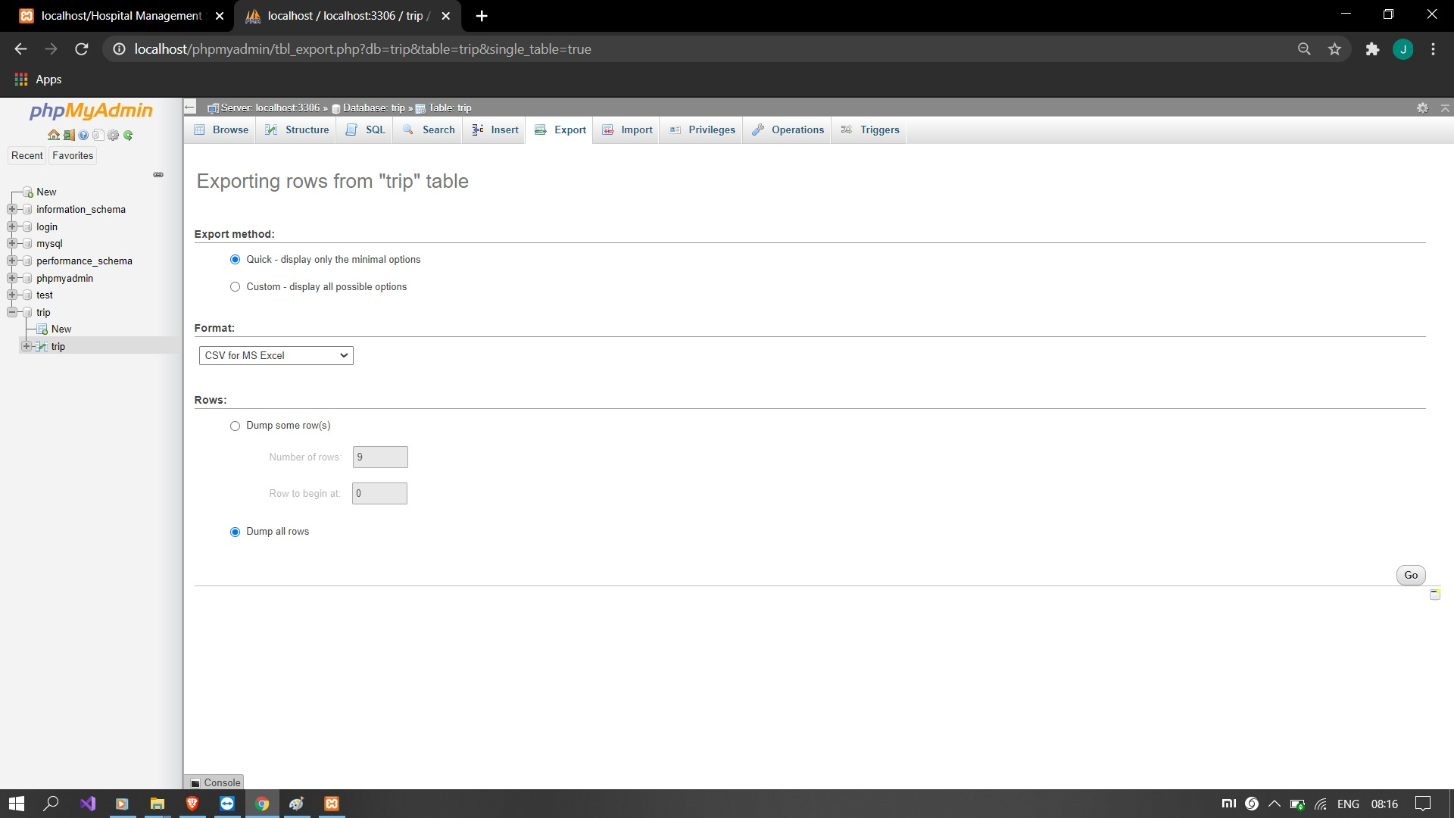
DATABASE

Slide 20
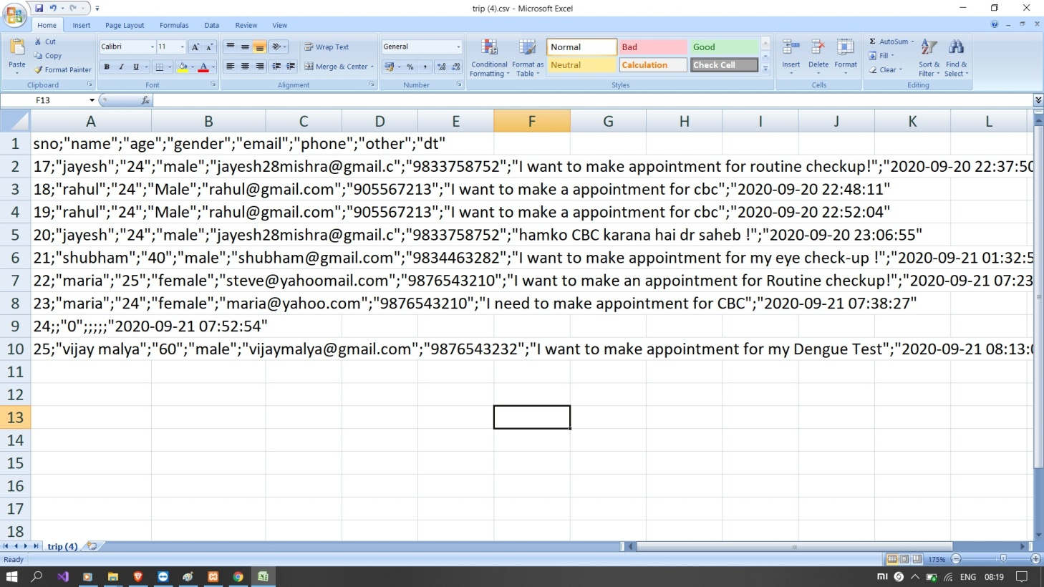
DATABASE CAN BE VIEWED IN:

Slide 21
Project Outcome
To make the existing system more efficient.
To provide a user friendly environment where user can be serviced better.
Make functioning of Application faster.
Provide a system where the Hospital staff can preschedule appointment and check records.
To minimize the loss done to books.

Slide 22
Future Enhancement
It is not possible to develop a system that makes all the requirements of the doctors. Hospital requirements keep changing as the system is being used.
As the technology emerges, it is possible to upgrade the system and can be adaptable to desired environment.

Slide 23
Conclusion
This Hospital Management System has been computed successfully and was also tested successfully by taking “test cases”. It is user friendly, and has required options, which can be utilized by the user to perform the desired operations.
The software is developed using php as front end and mysql as back end in Windows environment. The goals that are achieved by the software are:
Optimum utilization of resources.
Efficient management of records.
Simplification of the operations.
Less processing time and getting required information.
User friendly.
Portable and flexible for further enhancement.

